Slide 1


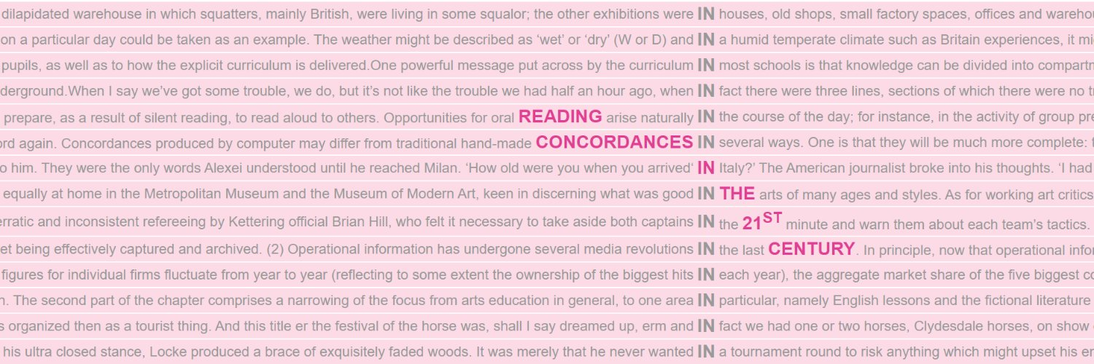



2
Reading concordances with algorithms
Konvens 2025 Tutorial | 9 Sep 2025
Reading Concordances in the 21st Century (RC21) project team
Nathan Dykes • Stephanie Evert • Michaela Mahlberg • Alexander Piperski

Slide 2
Overview of the tutorial
Part I
Concordance reading
Strategies for organising concordances
Reading concordances with algorithms
A mathematical framework
Part II
Hands-on: FlexiConc in Jupyter
Implementation details
Loading your own data

Slide 3
Overview of the tutorial
Part I
Concordance reading
Strategies for organising concordances
Reading concordances with algorithms
A mathematical framework
Part II
Hands-on: FlexiConc in Jupyter
Implementation details
Loading your own data

Slide 4







FlexiConc via Jupyter notebooks
FlexiConc Python library
Jupyter
notebook
Sketch Engine, KorAP, CLiC, CWB, CQPweb, WMatrix
https://pypi.org/project/FlexiConc/

Slide 5
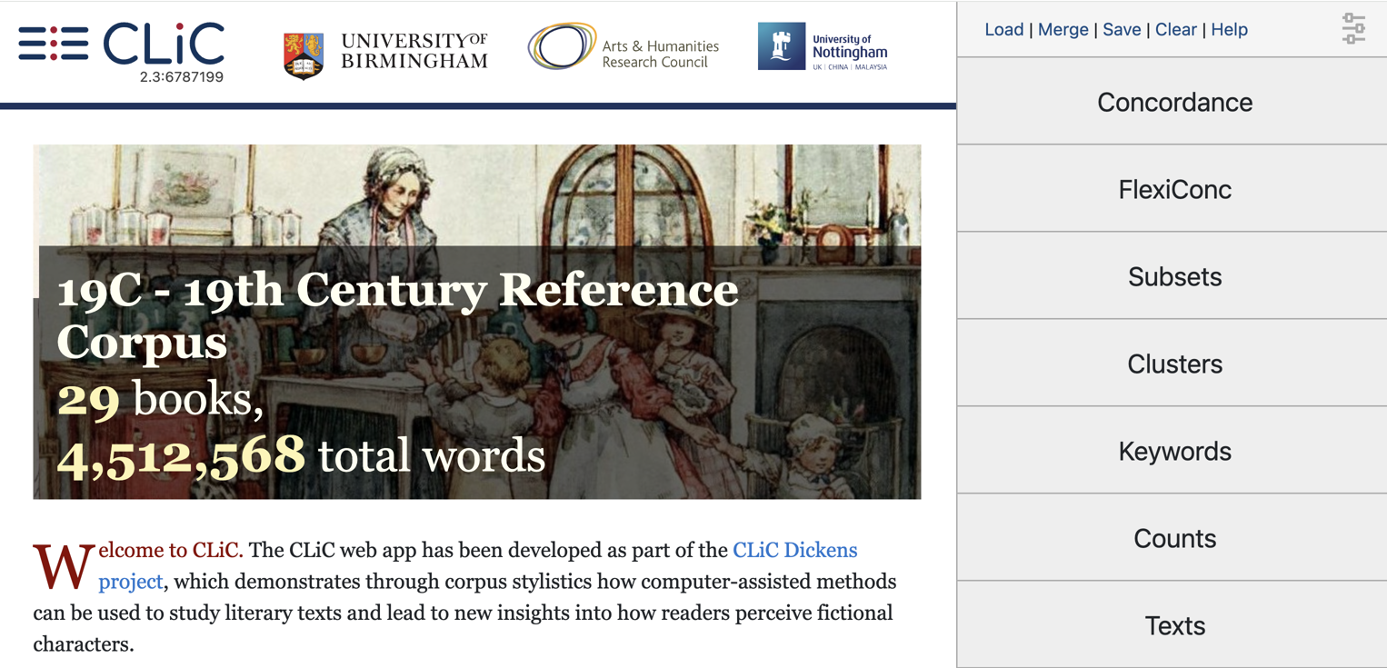

Hands-on: FlexiConc in CLiC
https://clic-fiction.com/

Slide 6
FlexiConc via Jupyter notebooks
Why FlexiConc? ➞ benefit from algorithmic innovation!
Use FlexiConc library from Python code in Jupyter notebook
Combines (some) interactivity with custom programming, e.g. to carry out additional anlayses not available in concordancer
Connect with various indexing & search backend to access your own corpora there ➞ FlexiConc has ready-made functions
The Right Way: install Jupyter Lab + FlexiConc on your computer
The easy way: run notebook in Google Colab … in a moment

Slide 7
Installing FlexiConc (Windows / MacOS)
install Anaconda Python or miniconda (anaconda.com/download)
create a separate environment for FlexiConc (conda create -n FlexiConc python=3.13)
don't forget to activate it (conda activate FlexiConc)
install PyICU from Anaconda (conda install pyicu)
install JupyterLab (conda install jupyterlab)
install FlexiConc and dependencies from PyPI with pip: pip install -U "flexiconc[notebooks,web,ICU,partitioning,annotation]"
now start JupyterLab (jupyter lab .) … or ask us for help

Slide 8
Installing FlexiConc (Linux)
create virtualenv: python3 -mvenv --upgrade-deps venv
activate virtualenv: source venv/bin/activate
install ICU (e.g. sudo apt install libicu-dev on Ubuntu)
install JupyterLab (pip install jupyterlab)
install FlexiConc and dependencies from PyPI with pip: pip install -U "flexiconc[notebooks,web,ICU,partitioning,annotation]"
start JupyterLab in your working directory: jupyter lab .
ask us for help if it doesn't work …

Slide 9

FlexiConc in Jupyter notebooks
First steps
flexiconc_introduction_Konvens 2025.ipynb
Download from Google Colab or copy and use it there
https://colab.research.google.com/drive/1sAC7c0vljy6og_dSwHbvbCs3QTs4a6Lx?usp=sharing

Slide 10
Overview of the tutorial
Part I
Concordance reading
Strategies for organising concordances
Reading concordances with algorithms
A mathematical framework
Part II
Hands-on: FlexiConc in Jupyter
Implementation details
Loading your own data

Slide 11
Representation of concordances in FlexiConc
In FlexiConc, a Concordance object must include two Pandas dataframes
metadata
information about concordance lines
tokens
information about individual tokens

Slide 12
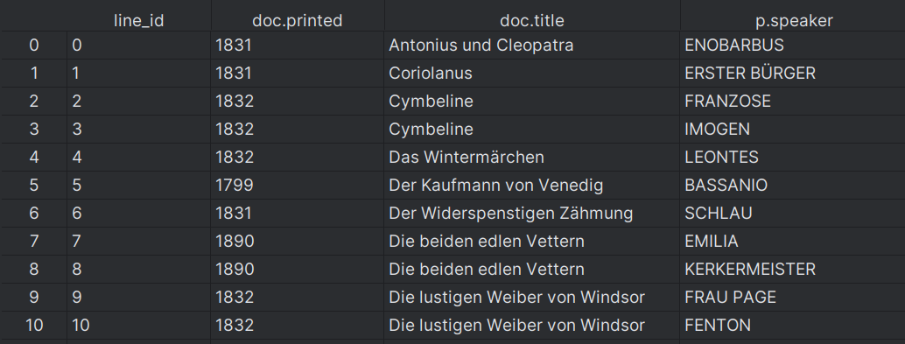
Representation of concordances in FlexiConc: metadata

Slide 13
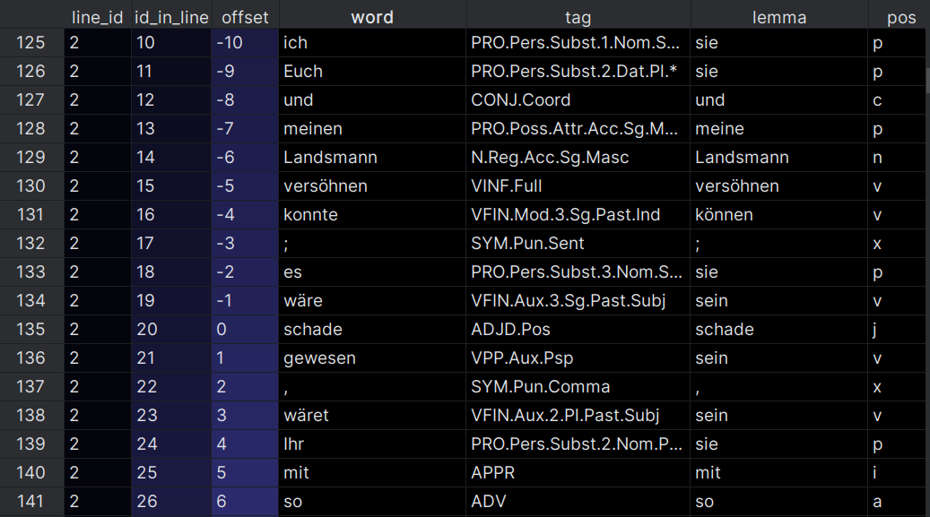
Representation of concordances in FlexiConc: tokens

Slide 14
Representation of algorithms in FlexiConc
Algorithms are stored as individual .py files in the algorithms folder provided with the package
Algorithms can also be loaded from user-specified folders
Each algorithms includes an exact specification as a JSON schema, which can be updated dynamically for each node
name
description
algorithm type
arguments
availability of an algorithm for a node

Slide 15
Representation of algorithms in FlexiConc: arguments
Schema for individual arguments
name
description
type
restrictions
list of possible values
min/max
...

Slide 16
Internal structure of an algorithm

Slide 17
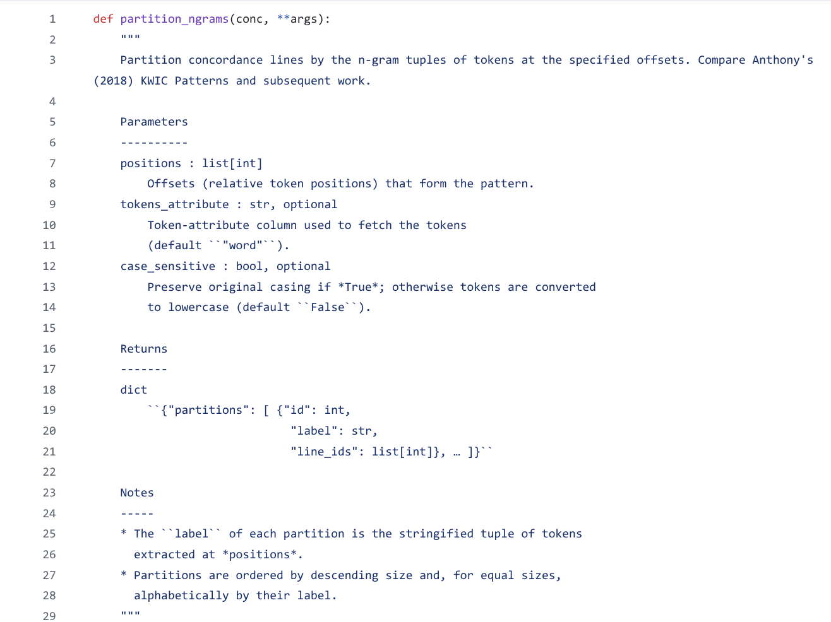
Docstring

Slide 18
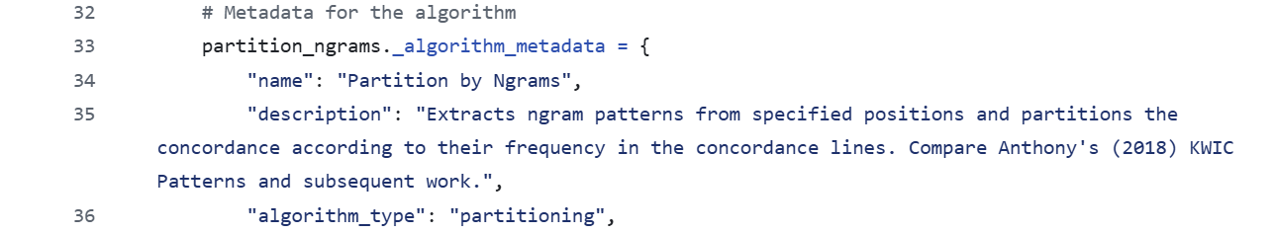
Metadata

Slide 19
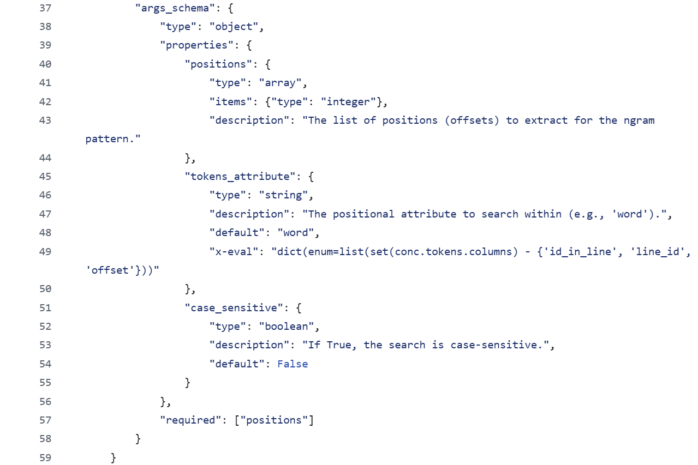
Argument schema
Dynamic list of possible values

Slide 20
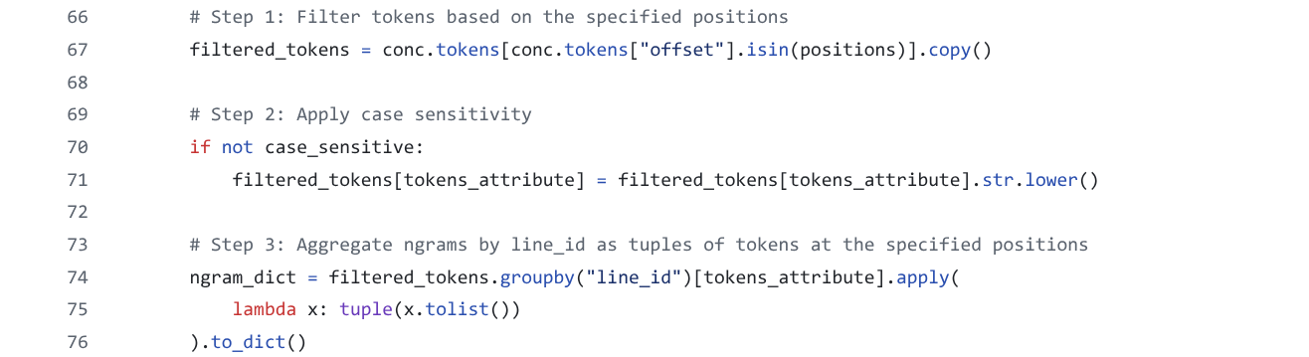

Slide 21
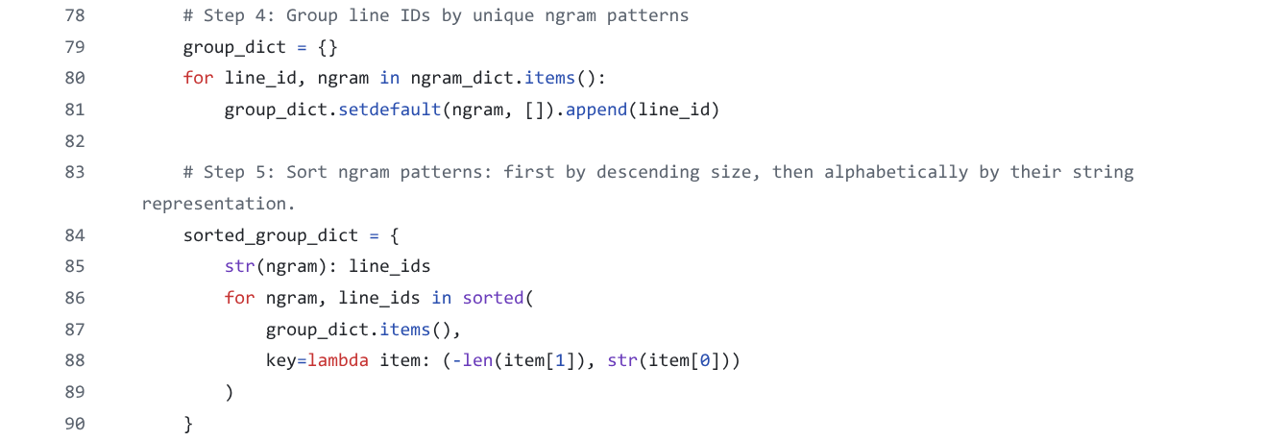

Slide 22
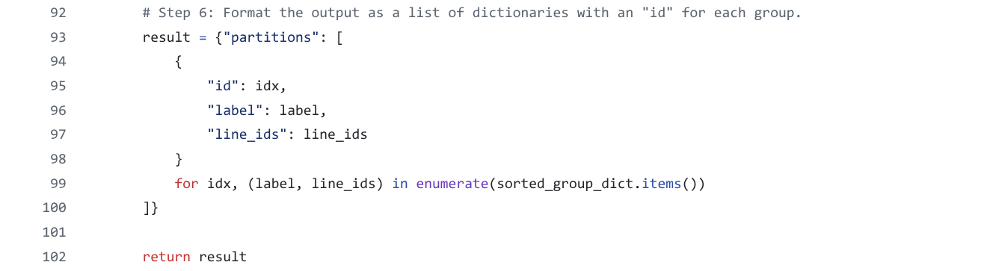
Creating custom algorithms should be doable!

Slide 23
Executing algorithms
Algorithms are applied to subsets of concordance lines and produce information about:
selected lines;
ordering of lines;
grouping of lines;
token spans to be highlighted in the concordance view.
Algorithms can only be accessed via add_subset_node and add_arrangement_node, ensuring that:
only permissible algorithm combinations are used;
any algorithm call is documented in the analysis tree;
the results of algorithm execution are stored correctly.

Slide 24
Overview of the tutorial
Part I
Concordance reading
Strategies for organising concordances
Reading concordances with algorithms
A mathematical framework
Part II
Hands-on: FlexiConc in Jupyter
Implementation details
Loading your own data

Slide 25

FlexiConc in Jupyter notebooks
Loading your own data:
flexiconc_import_Konvens 2025.ipynb
Download from Google Colab or copy and use it there
https://colab.research.google.com/drive/1HuVRl748lWe65Mzl5HNge4Wwgq5xiqw2?usp=sharing
After you’ve learned how to load your own data, explore a concordance of your choice. Then we’ll discuss your experiences and results.

Slide 26
Import from CLiC
https://clic-fiction.com/
Preparation: none
C = Concordance()
C.retrieve_from_clic(query=["head"], corpora="dickens")

Slide 27
Import from Sketch Engine
https://app.sketchengine.eu/
Prerequisite: paid SkE account (free 30-day trials available)

Slide 28
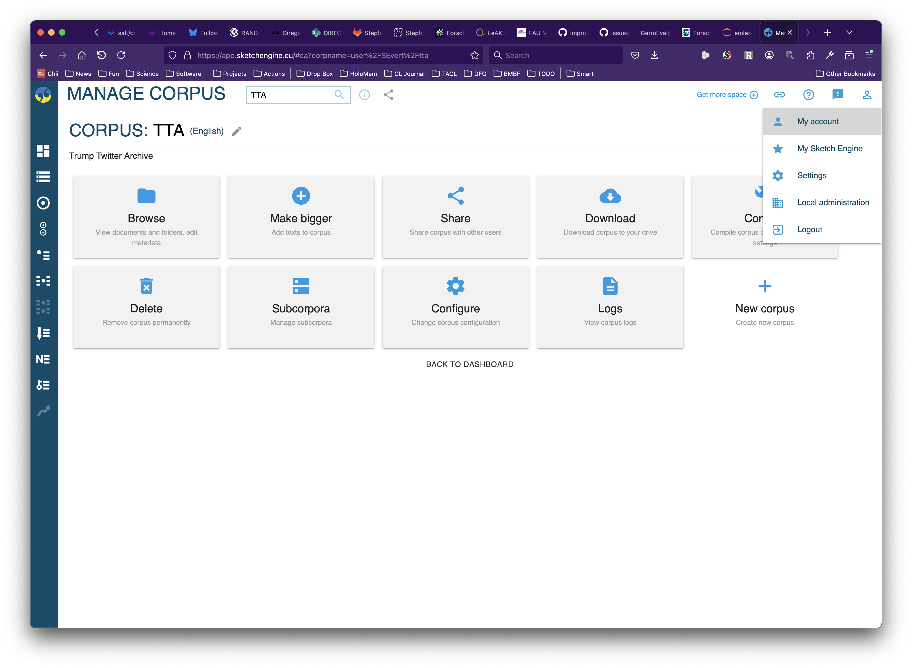
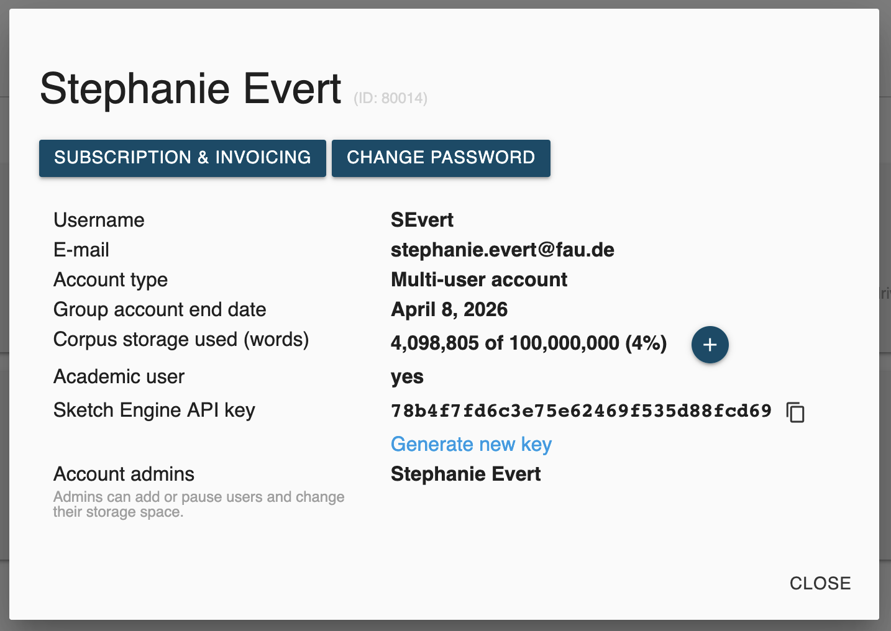
Import from Sketch Engine
https://app.sketchengine.eu/

Slide 29
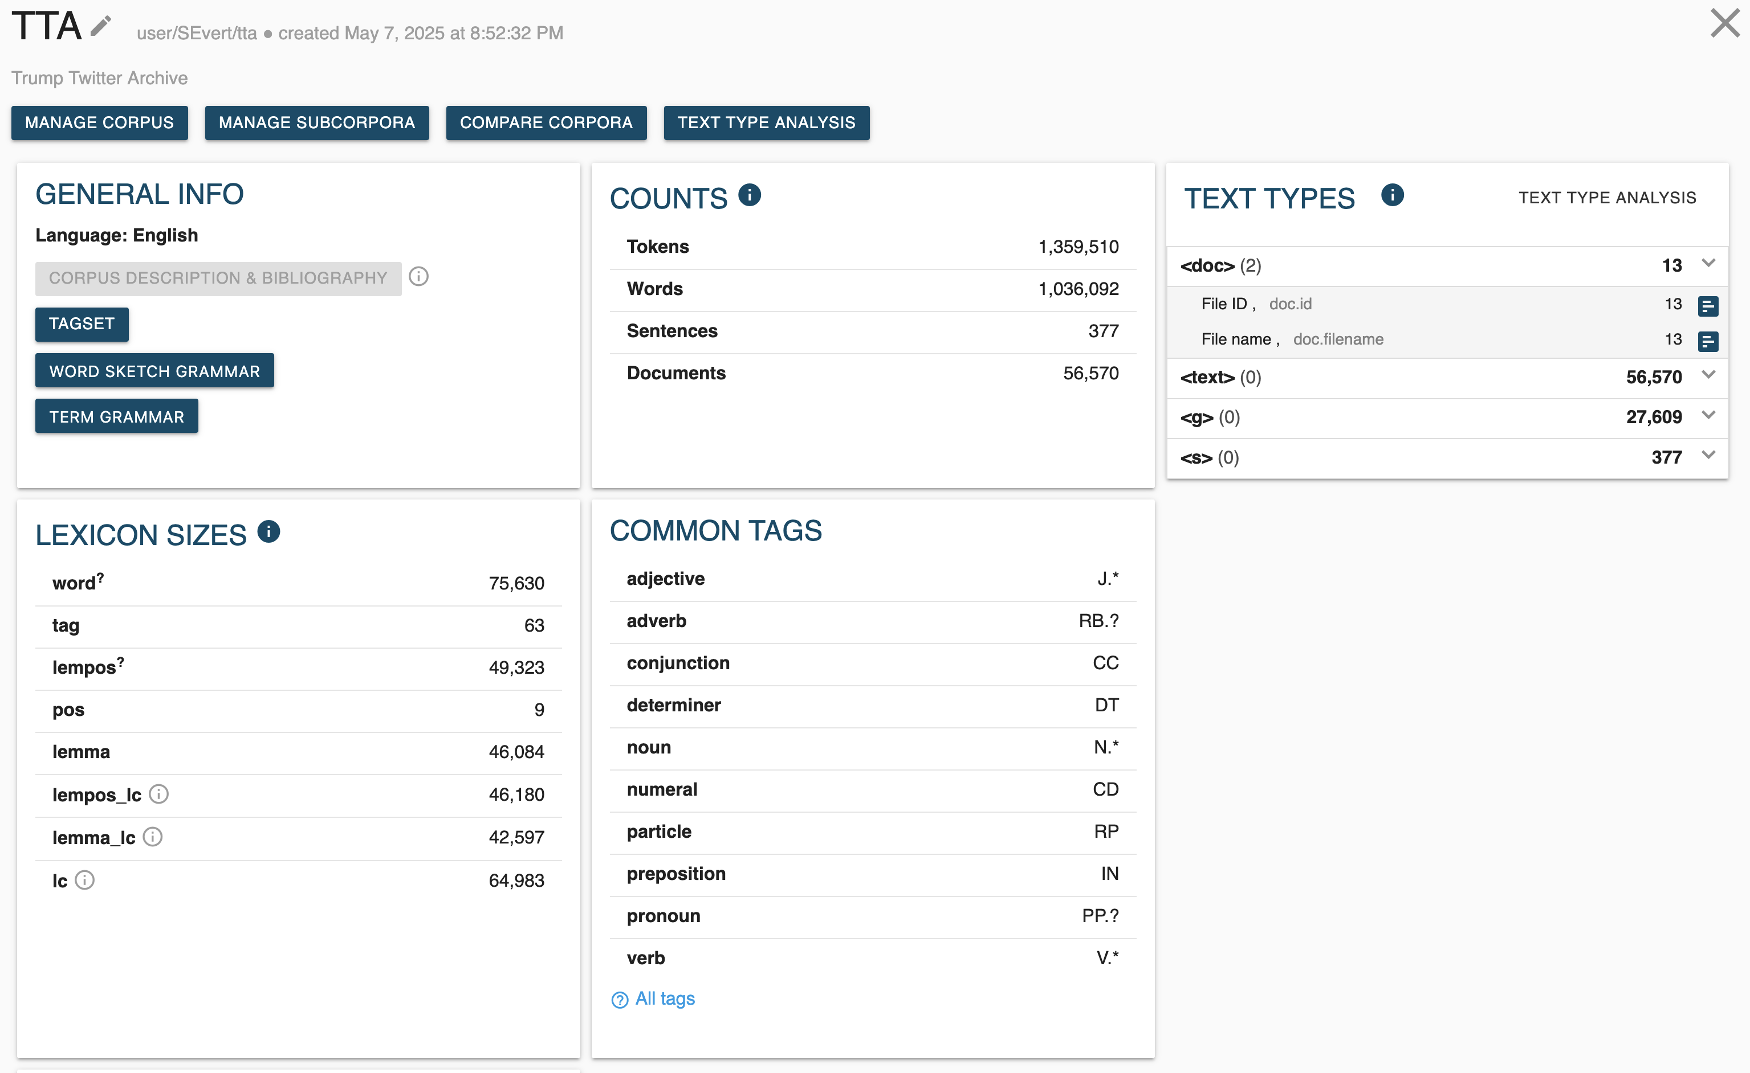
Import from Sketch Engine
https://app.sketchengine.eu/

Slide 30
Import from Sketch Engine
https://app.sketchengine.eu/
Prerequisite: paid SkE account (free 30-day trials available)
Generate API access token (as shown on previous slides)
Note down full path to desired corpus (as shown on previous slides)
C = Concordance()
C.retrieve_from_sketchengine(
query='[lc="fake"] [lc="news"]',
corpus="user/SEvert/tta", # insert your path here
api_key="[YOUR API KEY]")

Slide 31
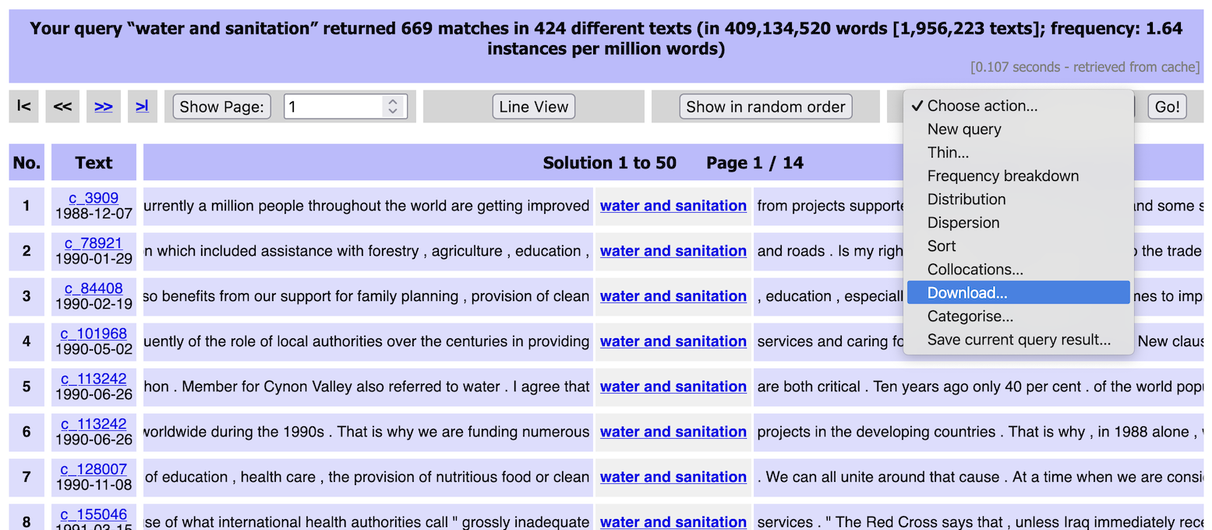
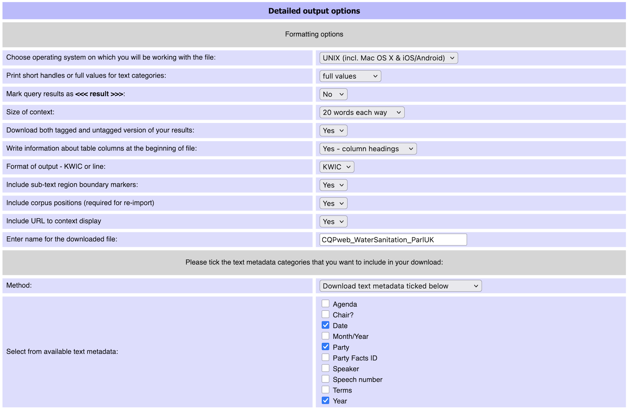
Import from CQPweb
https://corpora.linguistik.uni-erlangen.de/cqpweb/

Slide 32
Import from CQPweb
https://corpora.linguistik.uni-erlangen.de/cqpweb/
Demo account credentials: username: studentN, N ∈ {1, 2, …, 15} password: erlangen
Obtain desired concordance in CQPweb and save it with download action (as shown on previous slide)
Make sure to include all relevant metadata
Save the downloaded file in the same directory as the Jupyter notebook
C = Concordance()
C.load_from_cqpweb_export("CQPweb_WaterSanitation_ParlUK.txt")

Slide 33
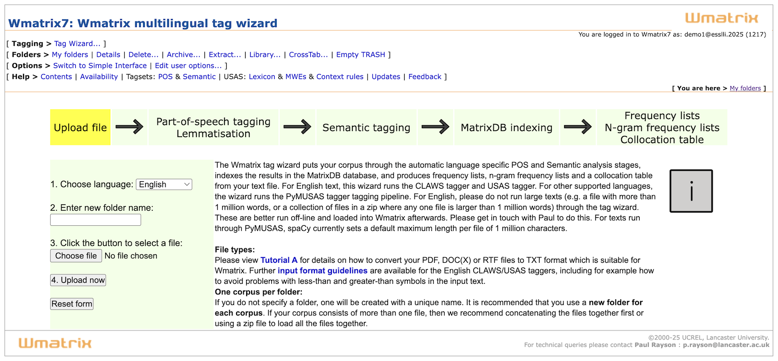
Import from WMatrix
https://ucrel-wmatrix7.lancaster.ac.uk/
Tag Wizard: Create your own corpus from text files in ZIP archive
Annotated with POS, lemma, semantic concept in 9 languages
Corpus (“folder”) can be downloaded in SQLite format

Slide 34
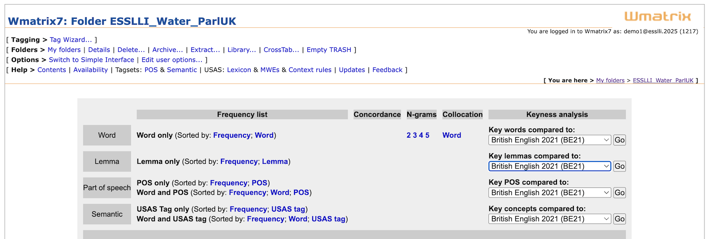
Import from WMatrix
https://ucrel-wmatrix7.lancaster.ac.uk/
Use own corpus (“folder”) or copy ESSLLI_Water_ParlUK from library
Main function: keyword analysis (for word, lemma, POS, concept)
Note interesting keywords ➞ concordance analysis in FlexiConc

Slide 35
Import from WMatrix
https://ucrel-wmatrix7.lancaster.ac.uk/
Get a free WMatrix account (or use our demo account)
Demo account credentials: username: demo1@esslli.2025 password: u73ripee4y
Download complete annotated WMatrix corpus
Then use query to obtain concordance for desired keyword
labour2005 = wmatrix.load(
corpus_name="LabourManifesto2005",
username="[USER]", password="[PASSWORD]",
db_filename="labour2005.db")
C = labour2005.concordance_from_query("community")

Slide 36
Import your own files
from flexiconc import TextImport
T = TextImport()
T.load_files(
paths=["data"],
shorten_paths=True,
db_name="db.sqlite",
use_spacy=True,
lemma=True,
pos=True,
tag=True
)
C = T.concordance_from_query("stomach")

Slide 37


Feedback and contributions welcome!
Please fill in our feedback form for this tutorial!
https://forms.gle/tRRVRbQHA4Qa2iFeA
Get in touch with us to contribute to our project blog!
experience with FlexiConc
concordance reading for your own research
needs/ideas for algorithms

Slide 38

Pro users: Import from CWB
Install IMS Open Corpus Workbench from cwb.sourceforge.io
Index your favourite corpus (or obtain a pre-indexed one)
Python API: pip install cwb-ccc
NB: will need complete development evironment with C compiler
C = Concordance()
C.retrieve_from_cwb(
corpus_name = "PARLSPEECH_UK",
query = r'[pos="JJ.*"] [lemma="elephant"]',
tokens_attrs = ["word", "pos", "lemma"],
metadata_attrs = ["text_party", "text_year", "text_date"])

